Slide 1
Collaborative Feature Modeling: An Extendable Voting-Based Approach with Divergence Tolerance and Consensus Facilitation
Li Yi
2010.05.04

Slide 2
Agenda
Background
Our Approach
An Example
Future Work

Slide 3
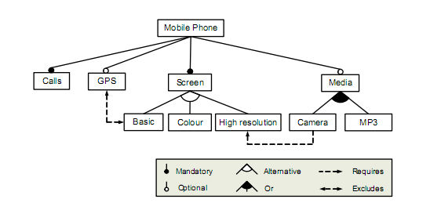
Background: Feature Models
Feature
Refinement
Constraint
from Feature Oriented Domain Analysis (FODA) Feasibility Study,
CMU/SEI-90-TR-21, 1990

Slide 4
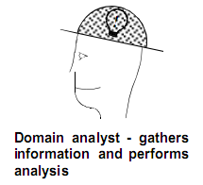
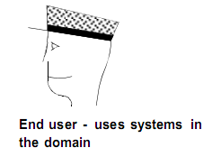
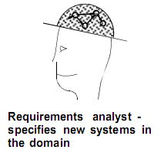
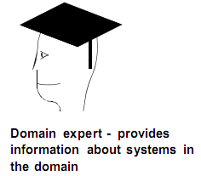
First, a feature model needs to be constructed…
…with collaboration between stakeholders
(from FODA & FORM)
FM

Slide 5
However, few of existing methods have supported such collaborations explicitly, leading to problems…
It takes a lot of effort for domain analysts to obtain knowledge from others, and the result is greatly depended on domain analysts’ experience
FM constructions are time-consuming and error-prone
The quality of constructed FMs cannot be well controlled
FMs are difficult to maintain and evolve with the domain

Slide 6
We propose a collaborative way to construct feature models
Why feature models can be constructed in such way?
Elements of a feature model are loosely coupled…
e.g. the proportion of constraints is usually low
…which means
a feature model can be constructed incrementally
a feature model can be divided into several parts, and these parts can be constructed concurrently

Slide 7
Agenda
Background
Our Approach
Concepts
Process
An Example
Future Work

Slide 8

Basic Idea
A Shared Feature Model
...
User 1 created feature Play Control
User 1 created feature Audio Control
User 2 created relation Audio Control refines Play Control
User 2 voted NO to feature Online Playing
User 1 created relation Online Playing requires Play Control
...
create/vote
Extendable Feature Model
create/vote
create/vote
The voting-based approach brings:
Divergence tolerance
Consensus facilitation
User 1 sees this feature model
User 2 sees this feature model

Slide 9
The Meta-model of Extendable Feature Models (EFM)
Create
Vote
Constraint
Operation
*
Relationship
User
Vote-able Element
Refinement
*
*
1
*
*
*
Feature
1
+parent
*
1
+child
EFM
1
Global
1
Attribute
String
*
1
1
Working
View
Text
1..*
1
1..*
Personal
Value
Type
Enumeration
Numeric
Default Attributes: Name, Description, Optionality

Slide 10
Operations for Users
Creating
a new feature
a new attribute for all features
a different value for an attribute
a new relationship
Voting
features
values of an attribute
relationships

Slide 11
Automatic Voting Propagation
The problem of inconsistent voting operation from one user
The user voted NO on it
The user voted YES on it
F-A
F-A
requires
requires
F-B
F-B
F-A should require F-B;
F-B should not exist;

Slide 12
Voting Propagation Rules (VPRs)
VPR-1a: Vote NO on Feature F → Vote NO on every Relationship R which involves F.
VPR-1b: Vote YES on Relationship R → Vote YES on every feature which is involved in R.
F-A
F-A
The user voted NO on it
A NO from the user is propagated to it
F-A
F-B
F-B
F-B
F-A
F-A
The user voted YES on it
A YES from the user is propagated to it
F-B
F-B

Slide 13
VPRs (Feature/Value)
VPR-2a: Vote YES on a value of an attribute of Feature F → Vote YES on F
VPR-2b: Vote NO on Feature F → Vote NO on all values of all attributes of F

Slide 14
Creating & Voting
Create a Vote-able Element VE → Vote YES on VE
All vote on VE is NO → Delete VE
All contributors have equal rights of decision.
NOTE: We don’t distinguish explicit votes from propagated votes.

Slide 15
Various Views for Each User
Global View of EFM e for user X
GV(e, X) = {all elements which has at least one YES vote}
Working View of EFM e for user X
WV(e, X) = {all elements on which X hasn’t voted NO}
Personal View of EFM e for user X
PV(e, X) = {all elements on which X has voted YES}
Anything available
Anything that I don’t dislike, or I haven’t noticed
Anything I want

Slide 16
Possible Usage of the Views
Use the working view as the main workspace.
Use the global view to avoid information missing.
Use personal views to track different perspectives.
PV of an end user
1
1
2
3
4
Service-Level
2
3
4
5
6
7
5
6
7
5
6
8
9
Function/Behavior-Level
8
9
10
PV of a programmer
10

Slide 17
Agenda
Background
Our Approach
Concepts
Process
An Example
Future Work

Slide 18
The Process
Stakeholder 1
Discuss with others
LEGEND
Submit operations
Switch between views
Stakeholder Activity
Supporting Activity
Propagate votes
Coordinate and apply changes
Artifact
Update views
EFM
Update views
. . .
Update views
Stakeholder 2
Stakeholder 3

Slide 19
Issues in the Process
Concurrency Control:
How to coordinate simultaneous operations from different stakeholders on the same element?
Model Checking:
What will happen if multiple operations leading to conflicts in the EFM (e.g. require-exclude conflict)?

Slide 20
Concurrency Control
The Create-Create conflict
create E
update EFM
create E
success
S1
S1
S2
time
S2
time
create E
create E
vote YES on E
Duplicate Creation
create name N for feature F1
create name N for feature F1
update EFM
success
S1
S1
S2
time
S2
time
create name N for feature F2
create name N for feature F2
fail and undo
Conflicting Aliases

Slide 21
Concurrency Control
The Vote-Vote conflict
vote NO on E
vote NO on E
(create)
update EFM
(create)
success
S1
S1
E
time
E
time
S2
S2
vote YES on E
vote YES on E
fail and undo
Unreachable Vote
The Create-Vote conflict
vote NO on F1
vote NO on F1
(create)
update EFM
(create)
success
S1
S1
F1
time
F1
time
S2
S2
create constraint F1 → F2
create constraint F1 → F2
fail and undo
Incomplete Creation

Slide 22
Model Checking
No model checking for the shared EFM
divergence tolerance
Need model checking for everyone’s working and personal view
Everyone is self-correct.
Perform model checking for working view only
The personal view is a subset of the working view.

Slide 23
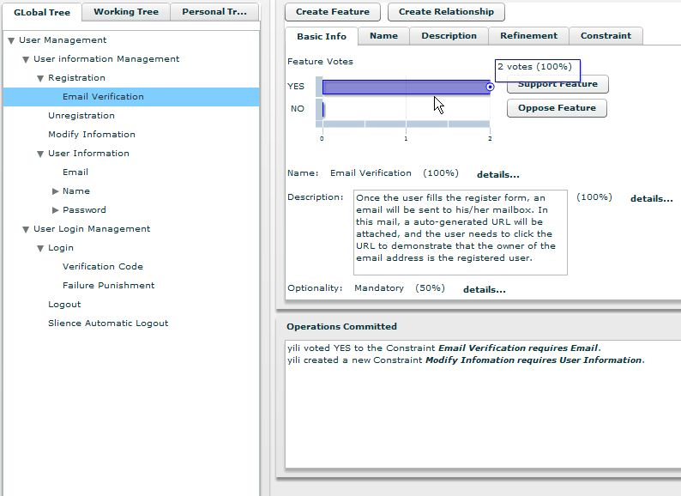
Feature Editor
Feature Model Browser
Miscellaneous Information

Slide 24
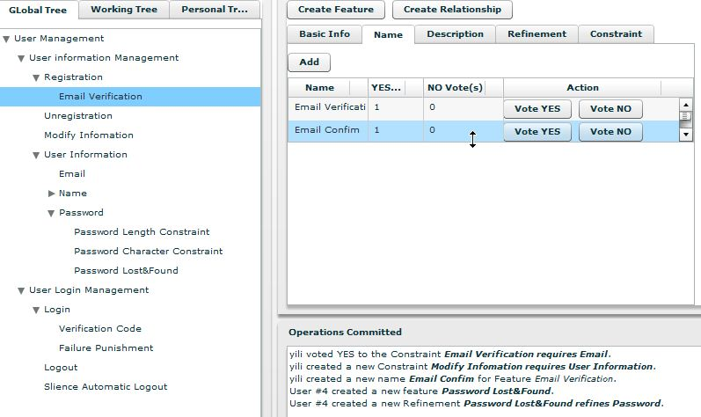

Slide 25
Agenda
Background
Our Approach
An Example
Future Work

Slide 26
An Example
A feature model of the “Music Player Software” domain is collaboratively constructed by 2 users
1. User A creates some features as a start.
Music Player
Play Control
Play
Pause
Stop

Slide 27
2.1 User B has different opinion on the refinements…
B’s working view (begin)
B’s working view (end)
Music Player
Music Player
Created by user A
Play Control
Play Control
Vote NO by user B
Created by user B
Play
Pause
Stop
Basic Control
Created by user A
Play
Pause
Stop

Slide 28
2.2 …and user B adds more features/relations.
B’s working view
Music Player
Created by user B
Created by user A
Play Control
Online Radio Playing
Basic Control
Audio Control
Play
Pause
Stop
Equalizer
Created by user A

Slide 29
3.1 After that, the model checking on user A’s working view reports an error. (3 features have more than one parent.)
A’s working view (begin)
Music Player
Created by user B
Created by user A
Play Control
Online Radio Playing
Basic Control
Audio Control
Play
Pause
Stop
Equalizer

Slide 30
3.2 User A agrees user B’s change of the refinements, but disagrees some other elements…
A’s working view (submitting operations…)
Music Player
Created by user B
Created by user A
Play Control
Online Radio Playing
Vote NO by user A
Vote NO by user A
Basic Control
Audio Control
Online Song Playing
Play
Pause
Stop
Equalizer
Newly created by A

Slide 31
A’s working view (end)
Music Player
Created by user A
Play Control
Online Song Playing
Basic Control
Audio Control
Created by user B
Play
Pause
Stop
Equalizer

Slide 32
4.1 Current working view of user B
Music Player
Created by user A
Play Control
Online Radio Playing
Online Song Playing
Basic Control
Audio Control
Created by user B
Play
Pause
Stop
Equalizer

Slide 33
4.2 Current EFM
Music Player
Divergence between A and B
Created by user A
Play Control
Online Radio Playing
Online Song Playing
Basic Control
Audio Control
Created by user B
Play
Pause
Stop
Equalizer

Slide 34
Future Work
Improvements
Voting propagation rules
Confidence of the votes
Details about extendable attributes
Tool Support and Case Studies
Group scale: small (3-5 persons), medium (10+)
Experience: low (an unfamiliar domain for most collaborators), centralized (a few experts), high (a familiar domain for most collaborators)

Slide 35
Thanks for your listening! Comments and questions are appreciated

